Slide 1

Chapter 8
Well-Being Across the Life Span

Slide 2
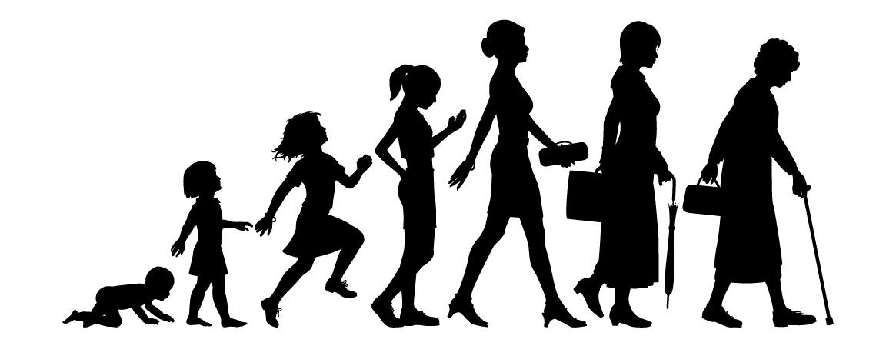
Well-Being Over the Life Span
Adult Development: a continuous process of anticipating the future, appraising and reappraising goals, adjusting to current realities, and regulating expectations to maintain a sense of well-being as circumstances change
Normative change (e.g. start career, get married, become grandparent)
Non-normative change (e.g., lose job)
Assimilation: keep striving for goals without major changes
Accommodation: change goals, assumptions, identity

Slide 3
Well-Being Over the Life Span
Stage Models and Well-Being
Each life stage has specific crisis
Purpose of each crisis helps to build a specific virtue
Dynamic balance of opposites—Ericson assumed successful resolution when healthy balance was achieved between the 2 poles
Unhealthy consequences if each pole taken to extreme
Healthy personality development
Notes:
Dynamic balance of opposites: Successful resolution of each stage challenge resulted in the two poles (positive and negative poles) finding a healthy balance.
Balance requires incorporating the adaptive elements of each pole and moderation requires not taking each pole to an unhealthy extreme that will inhibit healthy personality development.
Sixth stage of intimacy versus isolation
Intimacy refers to the ability to create healthy loving relationships.
Isolation refers to a fear of commitment and potential loneliness.
Stage seven of Erikson’s stage theory, generativity versus stagnation

Slide 4
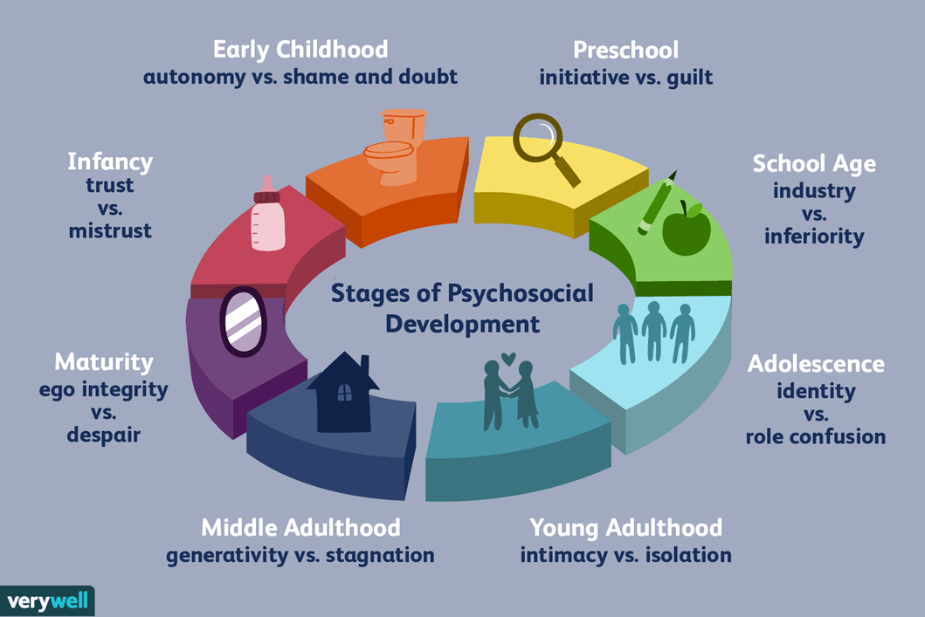
Eric Ericson’s Psychosocial Development Theory

Slide 5
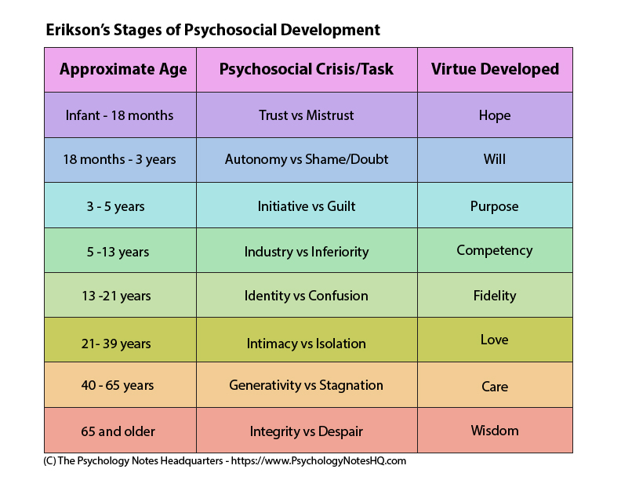

Slide 6
Well-Being Over the Life Span
Stage Models and Well-Being: Generativity: Nurturing and Guiding Others
Higher level of generativity is related to
greater well-being
greater maturity and personal growth
Use more principled moral reasoning
Balanced individualistic and communal concerns
Notes:
Generativity: Responsibility for each generation of adults to bear, nurture, guide those people who will succeed them as adults, develop and maintain those societal institutions and develop natural resources without which successive generations will not be able to survive

Slide 7
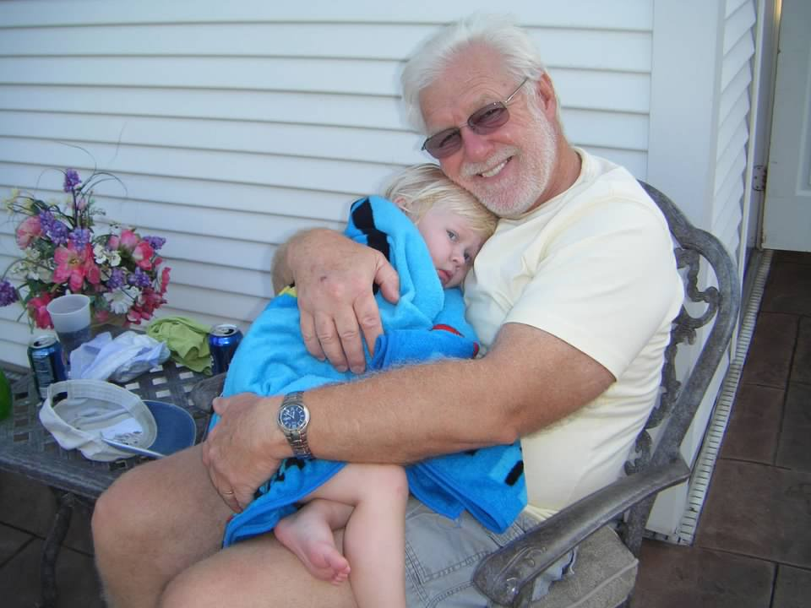
Well-Being Over the Life Span
Stage Models and Well-Being: Generativity: Nurturing and Guiding Others
Generativity associated with more education and middle age (need learning, experience)
Notes:
Generativity: Responsibility for each generation of adults to bear, nurture, guide those people who will succeed them as adults, develop and maintain those societal institutions and develop natural resources without which successive generations will not be able to survive

Slide 8
Well-Being Over the Life Span
Stage Models and Well-Being: Generativity: Nurturing and Guiding Others
Identities of highly generative people are known from their life stories
Have a commitment script: facing initial challenges in life may lead to greater sensitivity to others’ suffering which may lead to positive outcome benefiting others/society
Notes:
Generativity: Responsibility for each generation of adults to bear, nurture, guide those people who will succeed them as adults, develop and maintain those societal institutions and develop natural resources without which successive generations will not be able to survive

Slide 9
Well-Being Over the Life Span
Stage Models and Well-Being: Generativity: Nurturing and Guiding Others
Highly generative people do not experience more positive events or fewer stressors, rather it was how they interpreted those events ***
Life events perceived as events fostering empathy, compassion, and deeper understanding of others
Notes:
Generativity: Responsibility for each generation of adults to bear, nurture, guide those people who will succeed them as adults, develop and maintain those societal institutions and develop natural resources without which successive generations will not be able to survive

Slide 10
Well-Being Over the Life Span
Life Span and Life Course Models and Well-Being: Positive Youth Development
PYD posits youth possess resources that can be developed, nurtured, and cultivated
Strengths that help adolescents progress into adulthood:
Benefit Finding
Hope
Openness to Experience
Optimism
Curiosity
Notes:
Process that fosters the five Cs: Competence, confidence, connection, character, and caring.
Sixth C is contribution, or the effort to be involved in helping or serving others.
Penn Resiliency Program: It is devoted to positive youth development. It teaches children learned optimism, or how to reinterpret life events in a more positive and realistic fashion.

Slide 11
Well-Being Over the Life Span
Confidence
Life Span and Life Course Models and Well-Being: Positive Youth Development
Lerner: PYD is a process that fosters the five Cs (plus a 6th):
Competence
Connection
Character
Caring
Contribution
Notes:
Process that fosters the five Cs: Competence, confidence, connection, character, and caring.
Sixth C is contribution, or the effort to be involved in helping or serving others.
Penn Resiliency Program: It is devoted to positive youth development. It teaches children learned optimism, or how to reinterpret life events in a more positive and realistic fashion.

Slide 12
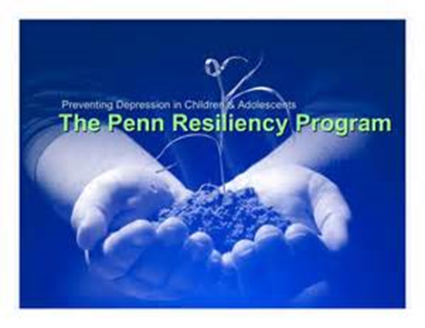
Well-Being Over the Life Span
Life Span and Life Course Models and Well-Being: Positive Youth Development
Penn Resiliency Program
Highly structured life-skills development program
Offered for a fee, or part of research
12 sessions in a classroom
Focus on thought patterns and attributions
Effective in reducing onset and severity of depression, promotes optimism and better health.
Notes:
Process that fosters the five Cs: Competence, confidence, connection, character, and caring.
Sixth C is contribution, or the effort to be involved in helping or serving others.
Penn Resiliency Program: It is devoted to positive youth development. It teaches children learned optimism, or how to reinterpret life events in a more positive and realistic fashion.

Slide 13
Well-Being Over the Life Span
Life Span and Life Course Models and Well-Being: Early and Middle Adulthood
Brandstadter posited dual process model of adaptation and adjustment
Pursuing goals, hit obstacles, then intensify efforts or later paths towards goals (assimilative…keep goal intact)
Goals that are impossible or blocked, then accommodative processes to adjust by downgrading importance of goal, switch to new goal, or use other strategies to adapt to loss of an important goal
Notes:
Fourfold classification at different life stages: That is, high/low SWB by high/low PWB
SWB: Subjective well-being
PWB: Psychological well-being

Slide 14
Well-Being Over the Life Span
Life Span and Life Course Models and Well-Being: Early and Middle Adulthood
Younger groups show:
more strengths concerned with exploring their worlds
strength of hope was a predictor of life satisfaction
Notes:
Fourfold classification at different life stages: That is, high/low SWB by high/low PWB
SWB: Subjective well-being
PWB: Psychological well-being

Slide 15

Well-Being Over the Life Span
Life Span and Life Course Models and Well-Being: Early and Middle Adulthood: Is There a Mid-Life Crisis?
Well-being relatively high at younger ages
Well-being decreases in midlife and rises again after 60…U-shaped curve found in
Major factors influencing the dip at midlife
Gender-specific
Midcareer evaluations (Midlife creates
many “frustrated achievers”…reevaluate
where they are in life, what they
have/have not accomplished, and inevitability
of aging)
Notes:
Well-being decrease in midlife and rise again after 60: Middle-aged group: Life satisfaction is predicted only by a higher capacity for loving relationships. In the older group: Greater, more self-reported usage of interpersonal and self-regulatory strengths.
Major factors influencing the dip at midlife: Major factors influencing the dip at midlife were gender specific and related to mid-career reevaluations.

Slide 16
Well-Being Over the Life Span
Life Span and Life Course Models and Well-Being: Early and Middle Adulthood: The Middle-Aged Brain
Some mental functions show a decline
Reaction times, ability to multitask, remember names
Some functions show improvement with age
Complex reasoning skills, empathy, inductive reasoning, verbal memory, making financial decisions, ability to see connections/grasp big picture
Middle-aged brain may be less quick, but more shrewd
Notes:
Some mental functions show a decline: Some mental functions, such as reaction time and abilities to multitask and remember names, do manifest a decline.
Some functions show improvement with age: Other functions actually show improvement with age. These include complex reasoning skills, empathy, inductive reasoning, verbal memory, making financial decisions, and the ability to see connections or to grasp the big picture.

Slide 17
Well-Being Over the Life Span
Life Span and Life Course Models and Well-Being: Successful Aging and Aging Well
Older persons are more satisfied with life
High subjective well-being among older persons (may include optimism and self-efficacy, higher sense of autonomy, more realistic view of future)
Happiness declines in old age…may remain happy if retain good health
Cultural factors influence well-being and older persons…higher life satisfaction for those from Western industrialized countries; Soviet Union, Eastern Europe, or Latin America large progressive decline; sub-Sahara Africa little change in well-being with advancing age
Notes:
High subjective well-being among older persons: Higher subjective well-being among older persons may include greater self-efficacy and optimism, a higher felt sense of autonomy, a more realistic view of the future, a more successful resolution of developmental life stages and a greater sense of meaning.
Older people are better at selecting less stressful environments and using anticipatory coping strategies to regulate emotion.
Older persons showed more temporal realism.
Physically active older persons are more satisfied, happiest of all age-groups.

Slide 18
Different Paths to Maturity: Individual Differences in Life Span Development
Mills Study
Followed women graduates of Mills College 1958 and 1960
Examined 4 criteria of maturity
Competence, wisdom, ego development, generativity
Women’s three distinct paths to positive adult development
Achievers
Conservers
Seekers
Depleted (pattern of unresolved emotional difficulties)
https://millslab.berkeley.edu/research.htm
Notes:
Four criteria of maturity: Competence, wisdom, ego development, and generativity.
Women’s three distinct paths to positive adult development: Achievers, Conservers, and Seekers
People regulate their emotions using primarily two strategies:
Affect optimization
Affect complexity
Four groups that each used a different emotional regulation style:
Integrated group
Defended group
Complex group
Dysregulated group

Slide 19
Different Paths to Maturity: Individual Differences in Life Span Development
Mills Study
Achievers
Highly achievement motivated
Competent
Career oriented
Ambitious
Scored highest on the measure of generativity
Had the most integrated sense of self-identity
Tied to max pos emotions, min neg feelings
Notes:
Four criteria of maturity: Competence, wisdom, ego development, and generativity.
Women’s three distinct paths to positive adult development: Achievers, Conservers, and Seekers
People regulate their emotions using primarily two strategies:
Affect optimization
Affect complexity
Four groups that each used a different emotional regulation style:
Integrated group
Defended group
Complex group
Dysregulated group

Slide 20
Different Paths to Maturity: Individual Differences in Life Span Development
Mills Study
Conservers
Competent but somewhat conventional
Emotionally reserved
Less open to change
Comfortable with identity but accepted identity others and society had expected of them
Adopted strategy of dampening emotions so both pos and neg kept in check
Notes:
Four criteria of maturity: Competence, wisdom, ego development, and generativity.
Women’s three distinct paths to positive adult development: Achievers, Conservers, and Seekers
People regulate their emotions using primarily two strategies:
Affect optimization
Affect complexity
Four groups that each used a different emotional regulation style:
Integrated group
Defended group
Complex group
Dysregulated group

Slide 21
Different Paths to Maturity: Individual Differences in Life Span Development
Mills Study
Seekers
Open to new experiences
Continued to question and challenge self
Valued personal growth over career success
Scored highest on wisdom and ego development
Had not accepted conventional definitions of who they should be, some were still searching for a stable self-identity in their early 40s
Amplified their emotions so both pos and neg feelings experienced more deeply
Depleted
Notes:
Four criteria of maturity: Competence, wisdom, ego development, and generativity.
Women’s three distinct paths to positive adult development: Achievers, Conservers, and Seekers
People regulate their emotions using primarily two strategies:
Affect optimization
Affect complexity
Four groups that each used a different emotional regulation style:
Integrated group
Defended group
Complex group
Dysregulated group

Slide 22
Different Paths to Maturity: Individual Differences in Life Span Development
Narrative Approaches to the Life Span: Telling Stories to Make Sense of Our Lives
Creative constructions from the actual events
Creative: we write our autobiographies and stories help to define our life for us
Life stories are important to our sense of well-being
Major functions for our personal stories
Aid in creation of sense of self
Help create a sense of meaning
Reminiscing: reviewing life narratives can lead to improved well-being

Slide 23
Different Paths to Maturity: Individual Differences in Life Span Development
Narrative Approaches to the Life Span: Telling Stories to Make Sense of Our Lives: Themes in Life Stories
Two types of narrative processing
Coherent positive resolution
narrative about a difficult event that has a positive ending and conveys a sense of emotional resolution and closure
These stories support and nurture interpersonal relationships
Exploratory narrative processing
involves a willingness to fully understand a difficult situation and to analyze it with openness and a full recognition of the negative emotional impact the event had on one’s life; leads to greater depth and more complexity to understanding life events
Tell these stories to help understand life in a more complex, compelling way
Notes:
Coherent positive resolution: This involves the creation of a narrative about a difficult event that has a positive ending and conveys a sense of emotional resolution and closure.
Exploratory narrative processing: Which involves a willingness to fully understand a difficult situation and to analyze it with openness and a full recognition of the negative emotional impact the event had on one’s life.
Transformation processing: These are narratives that contain both high positive resolution and high processing of negative emotions; these tended to be more consistently associated with indices of greater well-being.
Positive adaptation to difficult life events:
1. Explore the meaning and emotional impact of the event
2. Construct a coherent and positive resolution

Slide 24
Different Paths to Maturity: Individual Differences in Life Span Development
Narrative Approaches to the Life Span: Telling Stories to Make Sense of Our Lives: Themes in Life Stories
Transformation processing
Contain high coherent positive and high exploratory processing: contain both highly positive resolution and high processing of negative emotions
More consistently associated with greater well-being
Notes:
Coherent positive resolution: This involves the creation of a narrative about a difficult event that has a positive ending and conveys a sense of emotional resolution and closure.
Exploratory narrative processing: Which involves a willingness to fully understand a difficult situation and to analyze it with openness and a full recognition of the negative emotional impact the event had on one’s life.
Transformation processing: These are narratives that contain both high positive resolution and high processing of negative emotions; these tended to be more consistently associated with indices of greater well-being.
Positive adaptation to difficult life events:
1. Explore the meaning and emotional impact of the event
2. Construct a coherent and positive resolution

Slide 25
Different Paths to Maturity: Individual Differences in Life Span Development
Narrative Approaches to the Life Span: Telling Stories to Make Sense of Our Lives: Themes in Life Stories
Positive adaptation to difficult life events
1. explore the meaning and emotional impact of the event
2. construct a coherent and positive resolution
Cultural aspect of life stories
Stories reflect values and perspectives of our culture
Notes:
Coherent positive resolution: This involves the creation of a narrative about a difficult event that has a positive ending and conveys a sense of emotional resolution and closure.
Exploratory narrative processing: Which involves a willingness to fully understand a difficult situation and to analyze it with openness and a full recognition of the negative emotional impact the event had on one’s life.
Transformation processing: These are narratives that contain both high positive resolution and high processing of negative emotions; these tended to be more consistently associated with indices of greater well-being.
Positive adaptation to difficult life events:
1. Explore the meaning and emotional impact of the event
2. Construct a coherent and positive resolution

Slide 26
Adjusting to Difficult Life Events
Benefit finding
Positive interpretations of setbacks to see the event in a different light
Post-traumatic growth
Positive psychological change resulting from the struggle with highly challenging life circumstances or trauma
Refers to significant changes in life goals and life commitments that require major alterations in one’s sense of identity or life narrative
Can lead to improved mental health
Resilience
A broad array of abilities for constructively and positively adapting to risk, adversity, or some monumental negative event
A class of phenomena characterized by patterns of positive adaptation in the context of significant adversity or risk
Notes:
Benefit finding: Describes common but potentially transient adjustments to adversity.
Post-traumatic growth: Refers to significant changes in life goals and life commitments that require major alterations in one’s sense of identity or life narrative.
Resilience: The familiar descriptor for “a broad array of abilities for constructively and positively adapting to risk, adversity, or some monumental negative event.”

Slide 27
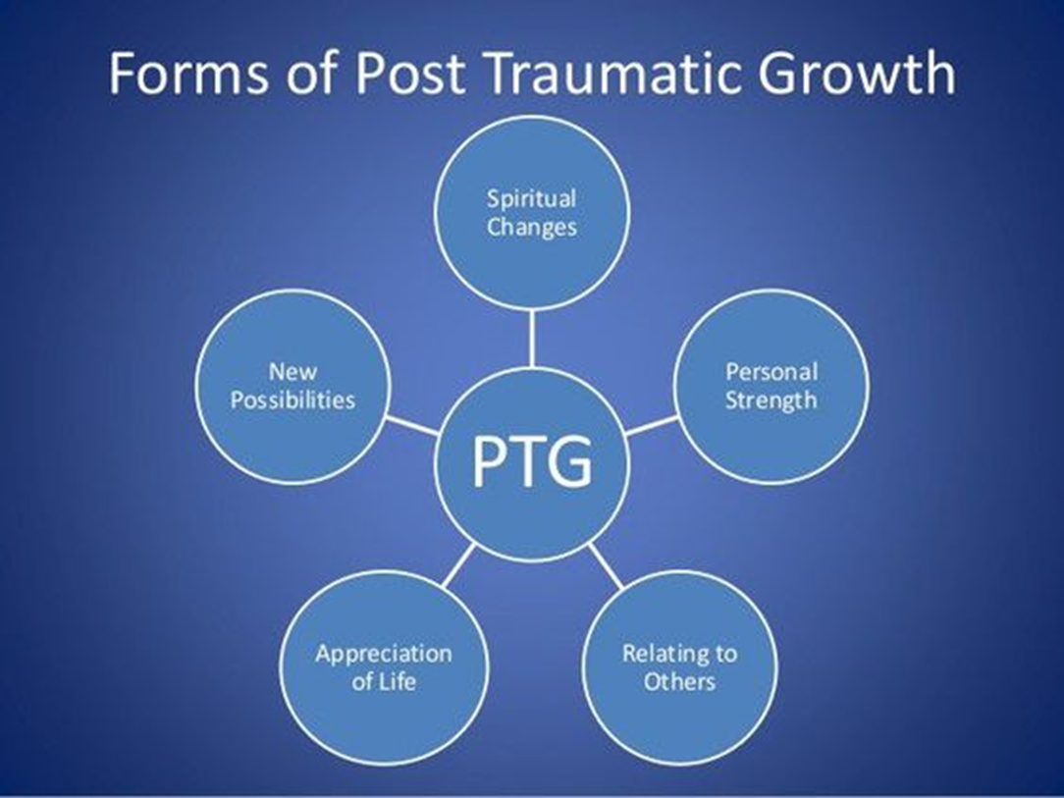

Slide 28
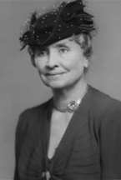
Resilience in Childhood
“The marvelous richness of human experience would lose something of rewarding joy if there were no limitations to overcome. The hilltop hour would not be half so wonderful if there were no dark valleys to traverse.”
- Hellen Keller

Slide 29
Adjusting to Difficult Life Events
Resilience in Children
Poor childhood environments may not result in psychological problems in adulthood
Werner 1970s research on resilient children, those who “bounced back” from adversity
Studied at-risk children of Kauai
Over 80% “bounced back” later in life
Attributed to having one supportive adult
Notes:
Core group of characteristics typical of resilient children: Across various studies, children have been found to be
Able to find a nurturing surrogate parent
Children had good social and communication skills and at least one close friend
Creative outlets, activities, or hobbies on which they could focus when life became even more difficult than usual
Children were relatively optimistic

Slide 30
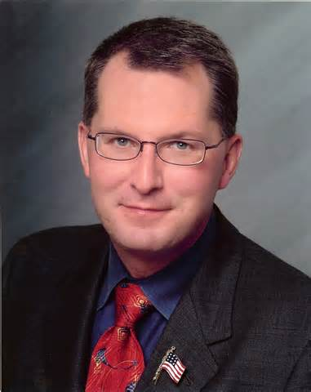
Dave Pelzer
Dave is a living testament of a self- made man, who as an optimist exudes resilience, service to mankind, personal responsibility, and faith in humanity
Dave nearly died several times by the hands of his mentally disturbed alcoholic mother.
Dave was starved, forced to drink ammonia, sit in bath tub for hours, stabbed and burned
Years later it was determined that Dave’s case was identified as one of the most gruesome and extreme cases of child abuse in California ’s then history.
Rescued at age 12
Placed in a series of foster homes until he enlisted in the U.S. Air Force at age 18.

Slide 31
Adjusting to Difficult Life Events
Resilience in Children
Core characteristics typical of resilient children
Able to find a nurturing surrogate parent
Children had good social and communication skills and at least one close friend
Creative outlets, activities, or hobbies on which they could focus when life became even more difficult than usual
Children were relatively optimistic
Actively involved in creating or finding environments and people supporting and reinforcing their competencies
Notes:
Core group of characteristics typical of resilient children: Across various studies, children have been found to be
Able to find a nurturing surrogate parent
Children had good social and communication skills and at least one close friend
Creative outlets, activities, or hobbies on which they could focus when life became even more difficult than usual
Children were relatively optimistic

Slide 32
Adjusting to Difficult Life Events
Resilience in Children: New Perspectives
Family factors influence children’s adjustment
At least one good relationship with a parent or sibling
Community factors help foster adjustments
Pos rels with peers, friends, trusted teacher
Participation in pos social or religious orgs
Sense of social cohesion or community involvement in neighborhood
Notes:
Community factors help foster adjustment: Positive relationships with peers, friends, or a trusted teacher, participation in positive social and community involvement in the child’s neighborhood.
Personality factors take up secondary role: Personality factors of children now take a secondary role to family and community factors.
Other factors: An ability to inhibit unwanted behavior and regulate emotions, high emotional intelligence, high self-efficacy and persistence, as well as insight into the complexities of diverse situations and behaviors.

Slide 33
Adjusting to Difficult Life Events
Resilience in Children: New Perspectives
Personality factors take up secondary role
Werner’s research, and:
Ability to inhibit unwanted behavior and regulate emotions
High emotional intelligence
High self-efficacy and persistence
Insight into complexities of diverse situations and behaviors
Other Factors: see Table 8.2
Notes:
Community factors help foster adjustment: Positive relationships with peers, friends, or a trusted teacher, participation in positive social and community involvement in the child’s neighborhood.
Personality factors take up secondary role: Personality factors of children now take a secondary role to family and community factors.
Other factors: An ability to inhibit unwanted behavior and regulate emotions, high emotional intelligence, high self-efficacy and persistence, as well as insight into the complexities of diverse situations and behaviors.

Slide 34
Adjusting to Difficult Life Events
Other Factors: see Table 8.2
Protective Factors for Resilience
In the Family/Close Relationships
Positive attachment, authoritative parenting, organized home environment, socioeconomic advantage
In the Community
Effective schools, ties to prosocial orgs, neighborhoods with high collective efficacy, good public health
In the Child
Good problem-solving skills, self-regulation, self-efficacy, positive outlook on life, faith and sense of meaning in life
Notes:
Community factors help foster adjustment: Positive relationships with peers, friends, or a trusted teacher, participation in positive social and community involvement in the child’s neighborhood.
Personality factors take up secondary role: Personality factors of children now take a secondary role to family and community factors.
Other factors: An ability to inhibit unwanted behavior and regulate emotions, high emotional intelligence, high self-efficacy and persistence, as well as insight into the complexities of diverse situations and behaviors.

Slide 35
Adjusting to Difficult Life Events
Emerging Adulthood
Five features to emerging adulthood
Identity explorations
Trying out different possibilities in work, love, ideology
Instability
Upheavals in work and love common
Self-focus
Relates to absorption with oneself rather than others
Feeling in-between
In-between adolescence and adulthood
Possibilities or optimism (Arnett)
Most emerging adult are optimistic about future
Notes:
Five features to emerging adulthood:
Identity explorations
Instability
Self-focus
Feeling in-between
Possibilities or optimism (Arnett)

Slide 36
Adjusting to Difficult Life Events
Emerging Adulthood
Experiencing identity confusion had lower psychosocial well-being
Fixed mind-set makes it difficult to handle challenges in the future (e.g, being told “you are so smart” rather than “you worked so hard”)
Growth mind-sets help in overcoming challenges
Growth mind set: attitude toward learning and challenges…can develop talent and ability through persistence, dedication, and passionate commitment
Notes:
Five features to emerging adulthood:
Identity explorations
Instability
Self-focus
Feeling in-between
Possibilities or optimism (Arnett)

Slide 37
Adjusting to Difficult Life Events
Resilience in Adulthood
Higher levels of resilience are associated with moderate adversity
Adversity in life helps us adjust and thrive
Lower resilience is associated with either a life of no adversity or high adversity

Slide 38
Adjusting to Difficult Life Events
Resilience in Adulthood: Cultivating Resilience in Adults
Positive emotionality helps increase in resilience
Several factors that enhance resilience
Task/problem focused coping, commitment to goals, humor, patience, optimism, faith, altruism, mindfulness and self-compassion, mature coping mechanisms
Requires finding delicate balance between too much and too little emotional control
Notes:
Factors for the cultivation of resilience: Other factors that enhance resilience include task- or problem-focused coping, commitment to goals, humor, patience, optimism, faith, altruism, mindfulness and self-compassion therapy and the use of mature defense mechanisms.
The APA suggests the following factors are generally important for the cultivation of resilience:
1. Make connections with family, friends, or community.
2. Avoid seeing crises as insurmountable problems.
3. Accept that change is part of living.
4. Move toward your goals.
5. Take decisive action, use problem- and task-focused coping.
6. Look for opportunities for self-discovery.
7. Nurture a positive view of yourself.
8. Keep events in perspective.
9. Maintain a hopeful outlook.
10. Take care of yourself, attend to your needs and feelings.

Slide 39
Adjusting to Difficult Life Events
Cultivating Resilience in Adults
APA: Factors for the cultivation of resilience
1. Make connections with family, friends, or community.
2. Avoid seeing crises as insurmountable problems.
3. Accept that change is part of living.
4. Move toward your goals.
5. Take decisive action, use problem- and task-focused coping.
6. Look for opportunities for self-discovery.
7. Nurture a positive view of yourself.
8. Keep events in perspective.
9. Maintain a hopeful outlook.
10. Take care of yourself, attend to your needs and feelings.
Notes:
Factors for the cultivation of resilience: Other factors that enhance resilience include task- or problem-focused coping, commitment to goals, humor, patience, optimism, faith, altruism, mindfulness and self-compassion therapy and the use of mature defense mechanisms.
The APA suggests the following factors are generally important for the cultivation of resilience:
1. Make connections with family, friends, or community.
2. Avoid seeing crises as insurmountable problems.
3. Accept that change is part of living.
4. Move toward your goals.
5. Take decisive action, use problem- and task-focused coping.
6. Look for opportunities for self-discovery.
7. Nurture a positive view of yourself.
8. Keep events in perspective.
9. Maintain a hopeful outlook.
10. Take care of yourself, attend to your needs and feelings.

Slide 40
Adjusting to Difficult Life Events
Resilience in Adulthood: Post-Traumatic Growth
Involves changes in self-understanding and one’s worldview, or meaning-making
Moving one toward important new goals…must disengage with old activities, strivings, core projects and create new goals that are intrinsically motivating and personally meaningful…authenticity involves action
Provides a renewed sense of meaning and purpose
Social support and acceptance are important factors in promoting post-traumatic growth

Slide 41
Adjusting to Difficult Life Events
Resilience in Adulthood: Sense of Coherence
Sense of Coherence Model: unique set of personality traits that helps people to interpret life stressors in a positive and adaptive way…coherent and understandable despite adversity
Sense of Coherence Model:
Meaningfulness
Comprehensibility
Extent to which life events appear ordered, consistent, structured and clear
Manageability
Sense of control derived from confidence in one’s coping skills
Higher sense of coherence associated with higher psychological well-being
Quite stable trait over the middle years of adulthood
Notes:
Sense of coherence comprises three major factors:
Meaningfulness
Comprehensibility
Manageability

Slide 42
Adjusting to Difficult Life Events
Resilience in Adulthood: Master Resilience Training
US Army Training: Teaches skills to inoculate against post-traumatic stress disorder
Set the seeds for future post-traumatic growth
Building mental toughness (learned optimism; gratitude journal)
Building character strengths (VIA)
Building strong relationships (module teaches about growth mind-set, constructive communication, and assertiveness training)
Notes:
Building mental toughness: Mental toughness skills are taught using techniques from learned optimism training as well as rational emotive and cognitive therapies.
Building character strengths: Character strengths are taught using the VIA Survey of Character to pinpoint individual signature strengths, especially those that help overcome challenges.
Building strong relationships: The strong relationships module teaches about growth mind-set, constructive communication, and assertiveness training to enhance both professional and personal relationships.

Slide 43
Adjusting to Difficult Life Events
Healthy and Adaptive Defense Mechanisms
Defense mechanisms describe one way we choose to deal with stress…choice has consequences for well-being
Mature Defense Mechanisms to conflicts, difficulties

Slide 44
Adjusting to Difficult Life Events
Mature Defense Mechanisms
Type of defense mechanisms used by a young person predicts well-being over 20 years later
Defense mechanisms based on the degree of unconsciousness and involuntariness
Psychotic (unhealthy, distorted to avoid anxiety)
Immature (often used by adolescents, those with severe depression)
Neurotic (“normal” such as repression, intellectualization, reaction formation, denial)
Mature and adaptive styles (altruism, anticipation, humor, sublimation, suppression; differs: attempting to maximize gratification while allowing awareness of underlying feelings, impulses, ideas, and consequences of behavior
Notes:
Psychotic: The psychotic defense mechanisms were clearly unhealthy and involved severe distortions of reality in an attempt to avoid anxiety.
Immature: Immature defense mechanisms were often used by adolescents and persons with severe depression.
Neurotic: Neurotic defense mechanisms as average or “normal” styles that most people use to cope with anxiety, threat, and conflict.
Mature and adaptive styles: These defense mechanisms deal with anxiety by attempting to maximize gratification, but at the same time allow awareness of underlying feelings, impulses, ideas, and consequences of behavior.

Slide 45
Adjusting to Difficult Life Events
Mature Defense Mechanisms: Outcomes
Had high incomes
Better psychological adjustment
More social supports
More joy in living
Better marital satisfaction
Higher self-rated health
Had jobs that fit their ambitions, were more active in public service, had gratifying friendships, enjoyed happier marriages, and were more engaged in competitive sports in midlife
Notes:
Psychotic: The psychotic defense mechanisms were clearly unhealthy and involved severe distortions of reality in an attempt to avoid anxiety.
Immature: Immature defense mechanisms were often used by adolescents and persons with severe depression.
Neurotic: Neurotic defense mechanisms as average or “normal” styles that most people use to cope with anxiety, threat, and conflict.
Mature and adaptive styles: These defense mechanisms deal with anxiety by attempting to maximize gratification, but at the same time allow awareness of underlying feelings, impulses, ideas, and consequences of behavior.

Slide 46
Adjusting to Difficult Life Events
Healthy and Adaptive Defense Mechanisms: Predictors of Thriving from the Harvard Study
Most important factor in aging well physically is to never smoke cigarettes
Good relationships help cognitive functioning in later life
Quality of relationship provides the key to greater well-being

